Slide 1

Can a Robot code my website?
Salman Iqbal
@soulmaniqbal
Notes:
Hi, thank you very much for staying behind to listen to my lightning talk. This is the last one so I am not going to drag it out for you.
My name is Salman Iqbal and the title of my talk is Can a Robot code my website? You can contact me on twitter on soulmaniqbal, if you would like to know more about this presentation and it will be great if you can give me feedback, this is my first talk at any conference so I want to thank the organisers for putting up an awesome event and letting me present.

Slide 2

Who am I?
Lead Developer at JLT, Bristol
C#, Web
Robotics
Machine Learning
Notes:
So who am I, I am a lead developer at JLT, we are based Bristol. It’s a financial institution and we work in Insurance, reinsurance, pensions and employee benefits.
As a lead developer on the web platform team, I get to code day-to-day, work on design, architecture, web, services, devops and whatever else needs to be done within reasonable limits. Mainly use C# plus whichever web framework is in favour for a few months.
I recently completed a masters in Robotics and machine learning is an interest of mine. If you use machine learning in your day-to-day job and otherwise I’d love to speak to you. So many interesting implementations. Yea that’s me on the right, in central Turkey, Capadocia, if you haven’t been I’d recommend, amazing landscape. I don’t get paid by Turkey tourism office, this was the only non-dull picture I had. Let’s get started

Slide 3
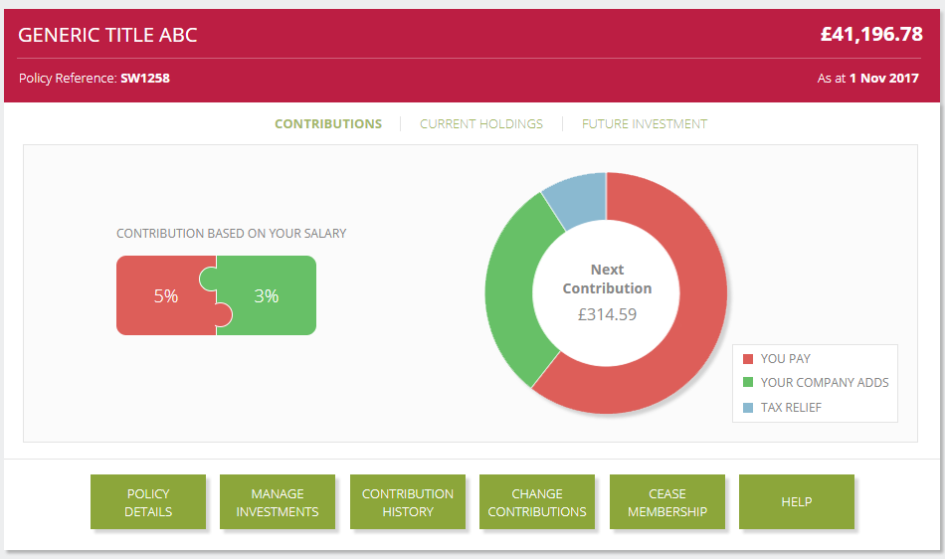
Expectation

Slide 4
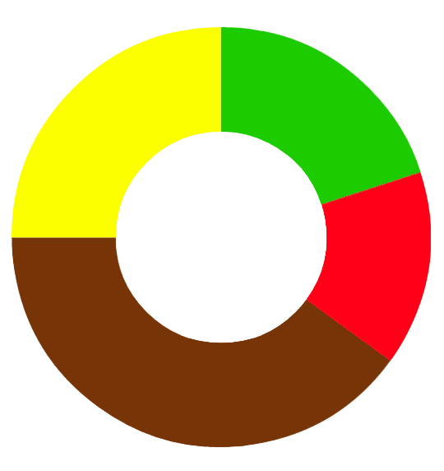

….Reality
JOKE TITLE ABC £24,032,018
Click Here
Don’t bother
I’m sorry
The best I could do
DDD Wales Rocks

Slide 5
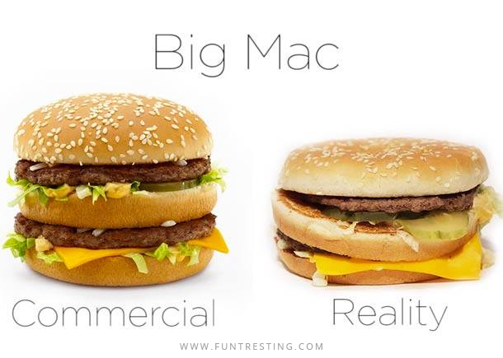
@soulmaniqbal

Slide 6
OK?
Anything can be OK.
It takes something special to be great.
People don’t take time out on Sat to be OK.
They are there to be great!
@denhamparry

Slide 7

Notes:
If you were expecting to roll out a robot that could code live right in-front of you, I am sorry I have to disappoint you. Maybe some other day

Slide 8
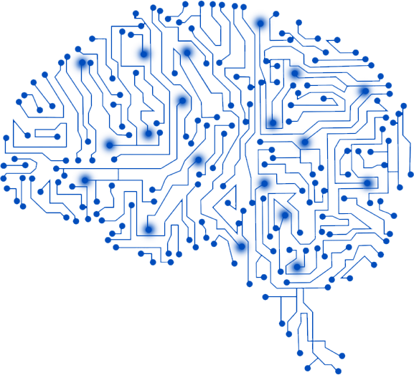
Deep Learning
industryolog.com
@soulmaniqbal

Slide 9
Deep Learning
Software that mimics neuron layers activity in neocortex & learns to recognise patterns in digital representations
- MIT Technology Review
Notes:
Deep-learning software attempts to mimic the activity in layers of neurons in the neocortex, the wrinkly 80 percent of the brain where thinking occurs. The software learns, in a very real sense, to recognize patterns in digital representations of sounds, images, and other data.
Definition adapted from here: https://www.technologyreview.com/s/513696/deep-learning/

Slide 10
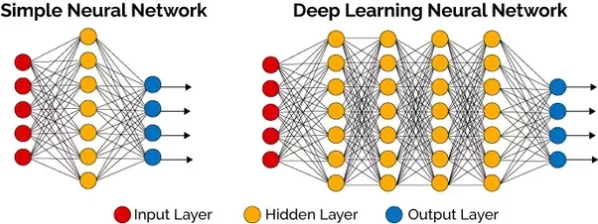
Neural Networks
Quora.com
@soulmaniqbal
Notes:
Simple ANN: Used in image detection, each circle is a artificial neuron and it’s job is to be trained to fire or not fire based on a particular input pattern. Just like the brain you get a few of these and you connect them together, there are 3 layers as you can see. In deep learning, you get a few more hidden layers, that’s pretty much it.
So now we will look at how deep learning can be used to convert a mockup to a Website with HTML and CSS

Slide 11
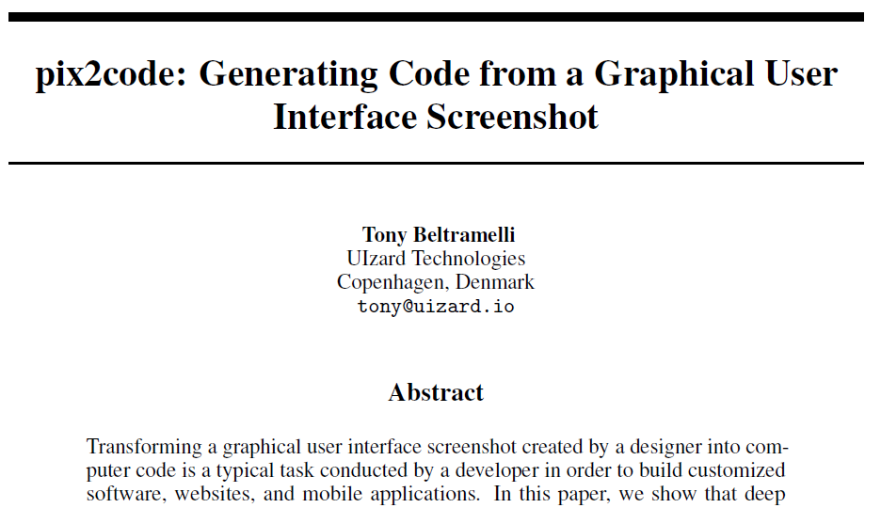
Notes:
19 Sept 2017- Also Airbnb’s sketch2code

Slide 12
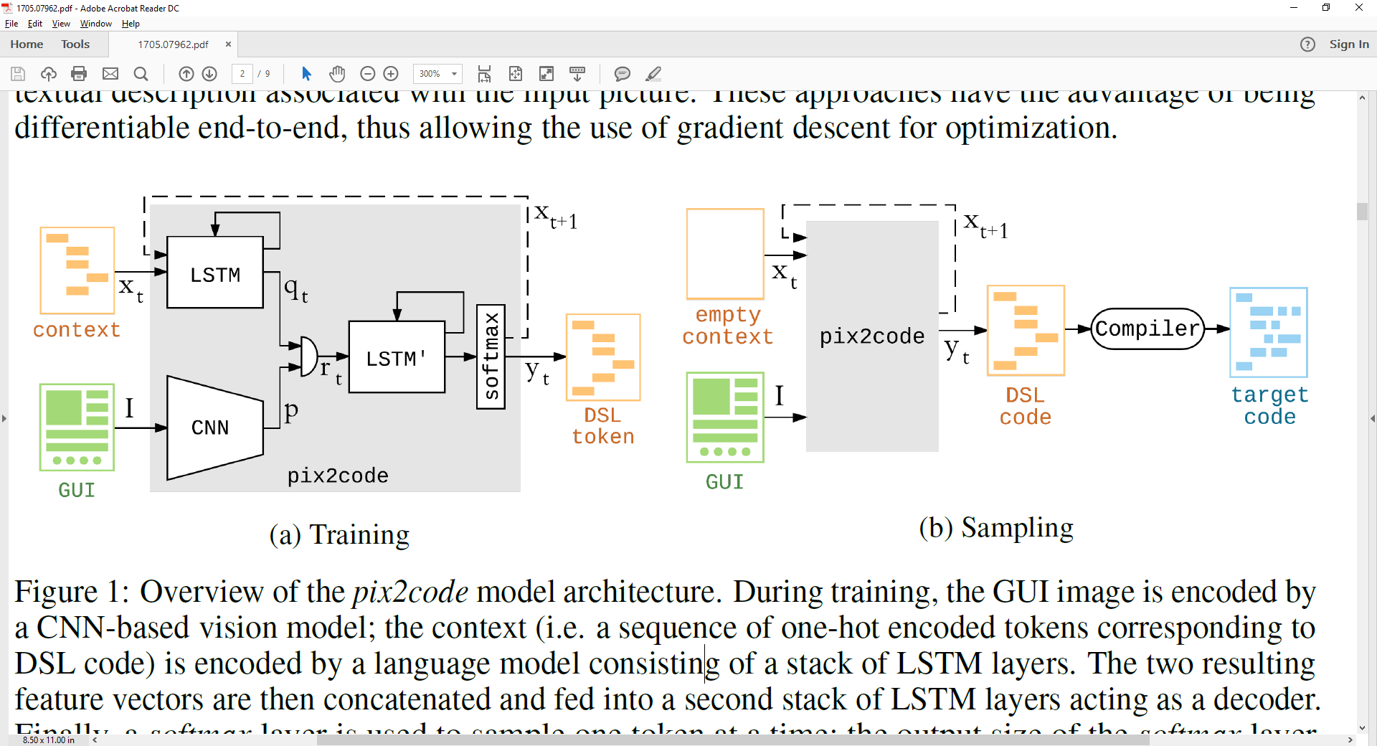
pix2code
@soulmaniqbal
Notes:
Screenshot -> Convolutional Neural Network
Context -> What kind of semantics we are after, html tags etc into Long short-term memory type of recurrant neural network

Slide 13
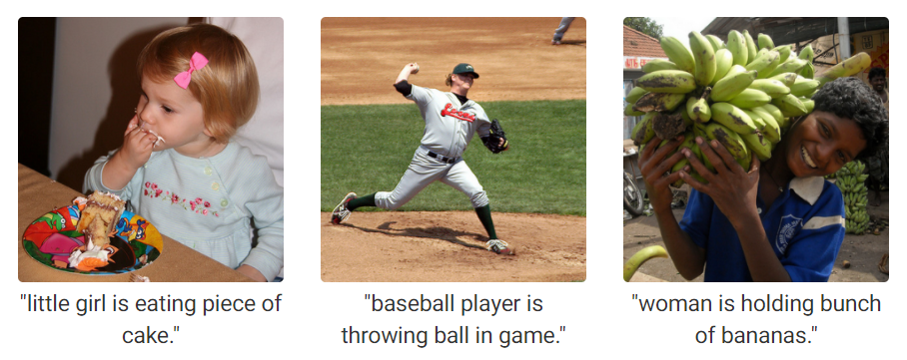
Image Descriptions
https://cs.stanford.edu/people/karpathy/deepimagesent/
Notes:
I am sure you’ve seen different versions of this floating around. Given an image, the algorithm works out the best description of the image. This is from Stanford project. They used CNNs over images and RNNs over sentences and combined the two together like the pix2code

Slide 14
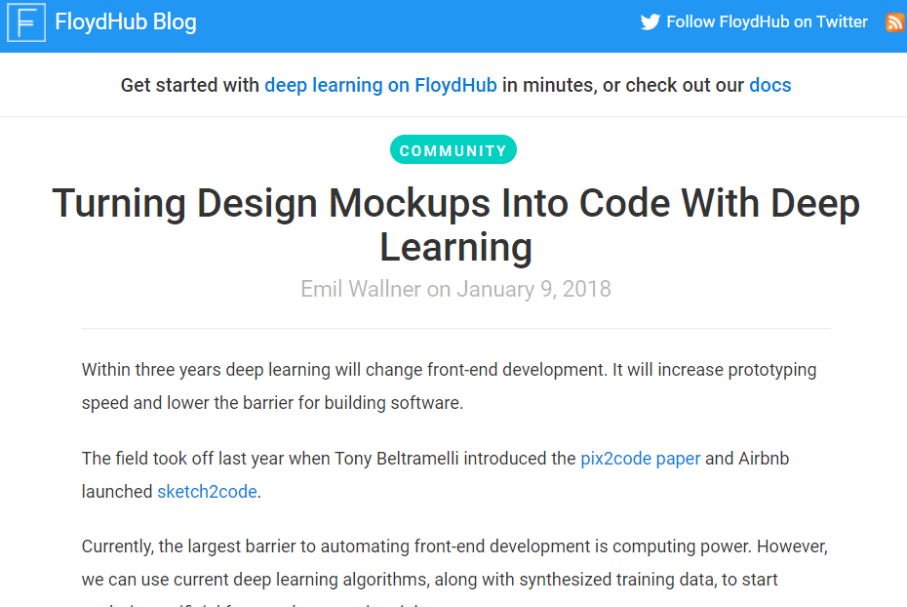
https://blog.floydhub.com/turning-design-mockups-into-code-with-deep-learning/
Notes:
FloydHub is a Platform-as-a-Service for training and deploying your deep learning models in the cloud. It’s like Heroku for deep learning. You can get a free account to and you can run 1 concurrent job at a time. And public account.

Slide 15
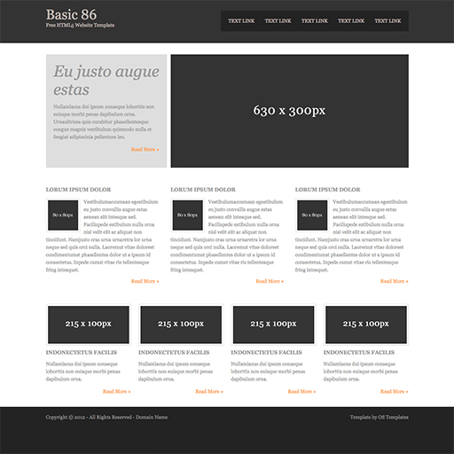

Slide 16
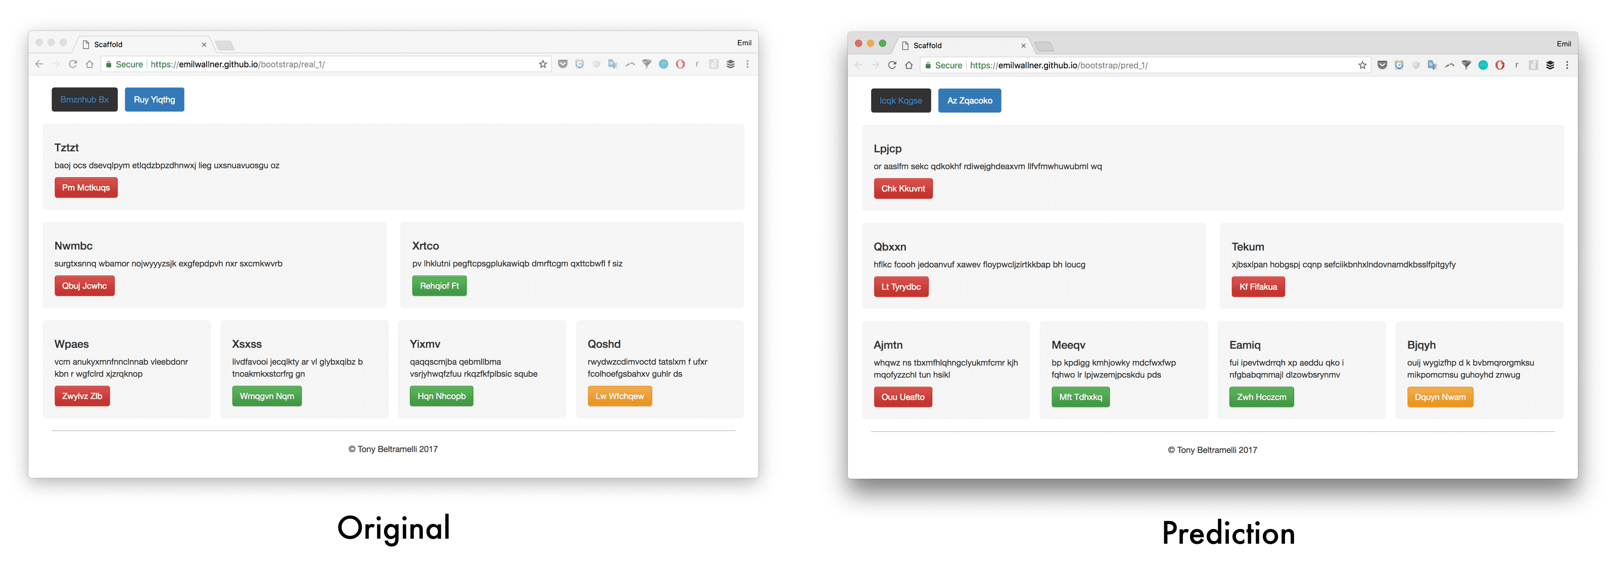
pix2code
@soulmaniqbal

Slide 17

Can a robot code my website?
YES
*
*Depends on training
@soulmaniqbal

Slide 18


Cloud Native Wales
cloudnativewales.io
@cloudnativewal
@soulmaniqbal

